Slide 1
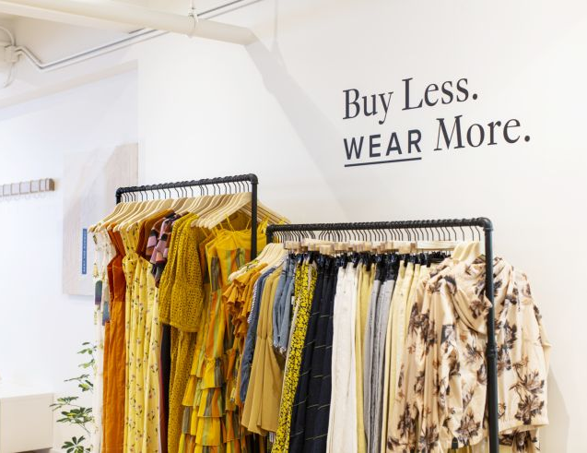
Fashion Rental Management Database System
GROUP-14
Alisha Khan 002920188
Rushikesh Karwankar 002776313
Seona Rodrigues 002760607
Sakshi Sasalate 002742867

Slide 2
Objectives
With the rapidly changing fashion trends and need of prioritizing affordability and sustainability “Fashion Rental Management ” is our solution that allows customers to rent designer clothing and accessories instead of buying it
The database solution will provide customers with access to a broad selection of merchandise, allowing them to explore, make rental bookings
With the database, the organization can track customers' browsing behavior, identify popular fashion rental categories, and make informed decisions about inventory restocking and management

Slide 3
Design Considerations
Database Design: Follow best practices for database design, including normalization, appropriate data types, and proper use of database objects such as views, stored procedures, and functions
Performance- Optimize query performance by indexing tables, normalizing data, and minimizing the use of triggers or complex calculations
Security: Implement security measures, such as strong authentication, encryption to protect sensitive data from unauthorized access
Data Integrity: Enforce data integrity constraints, such as primary keys, foreign keys, and check constraints, to maintain data accuracy and consistency

Slide 4
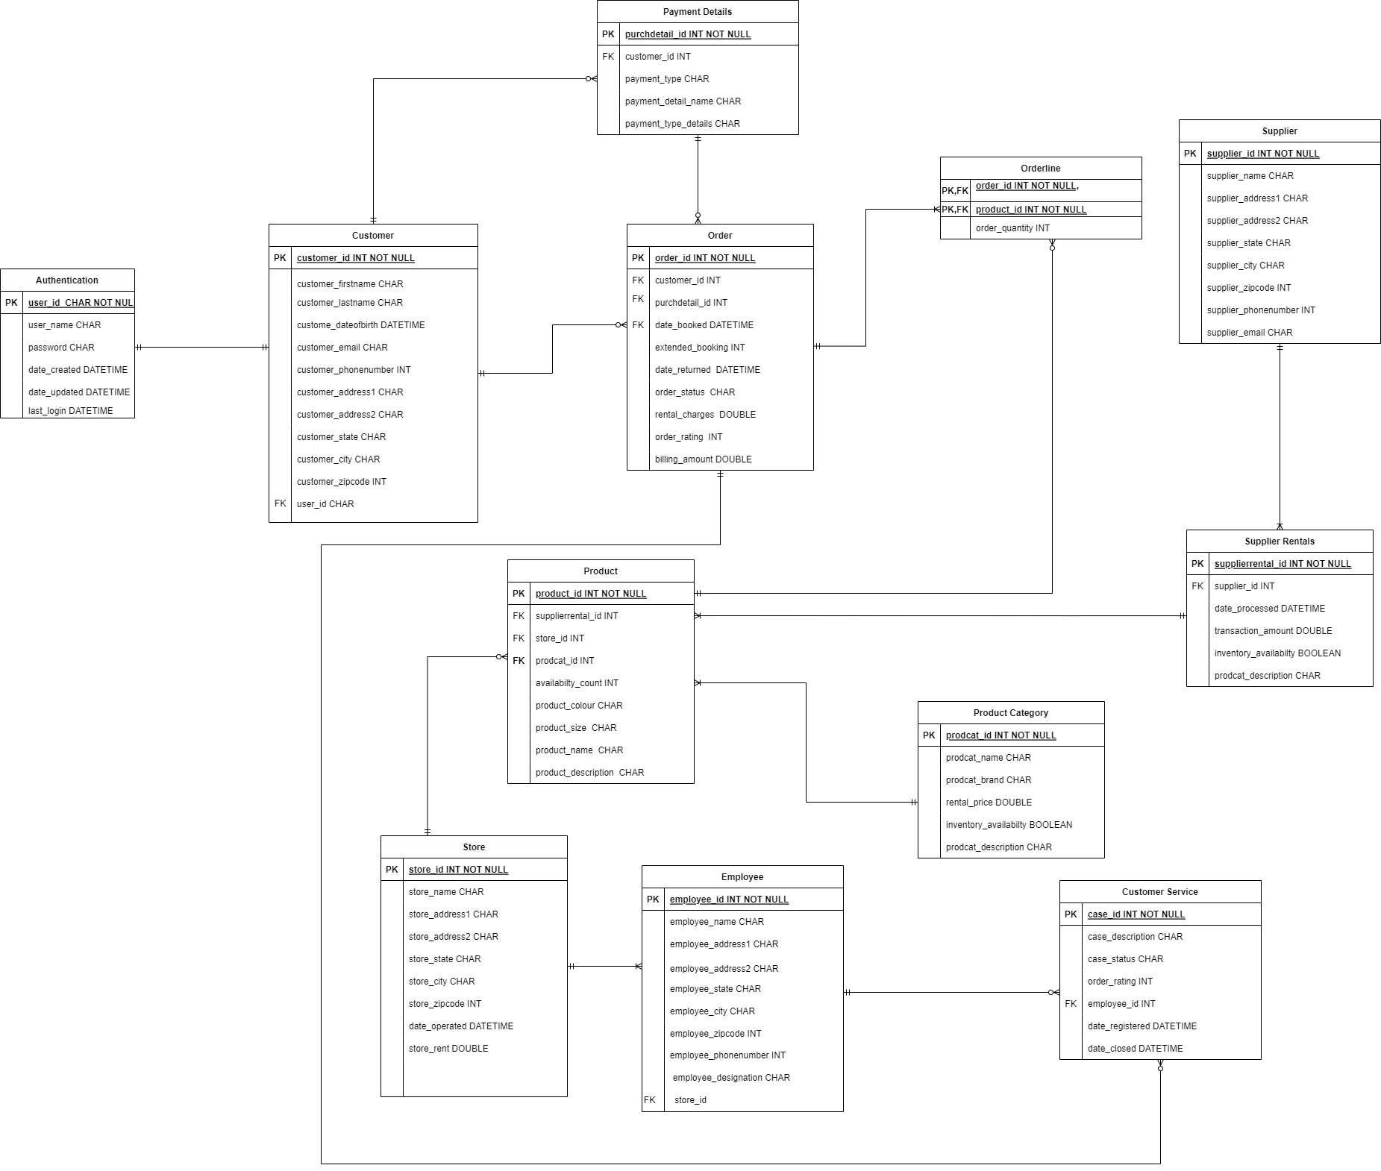
ERD

Slide 5
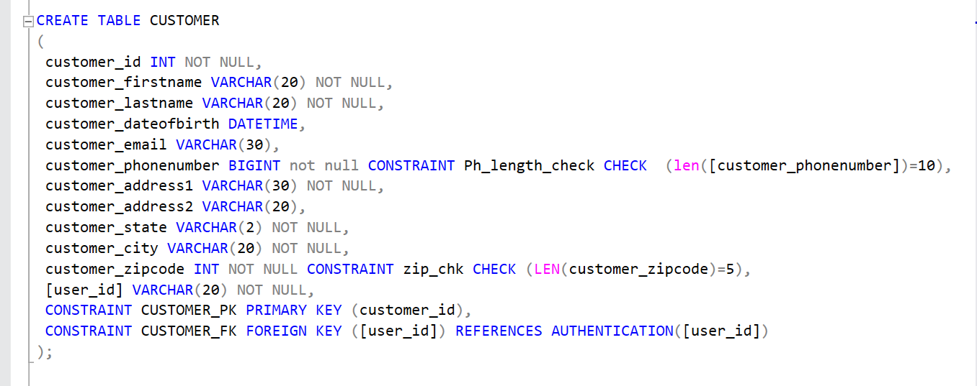
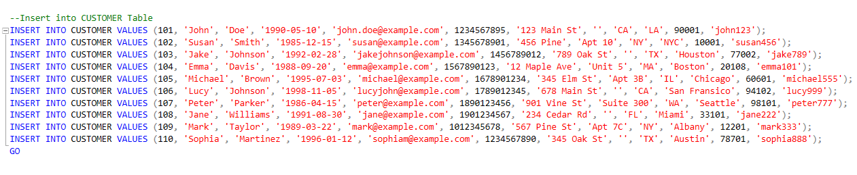
Database DDL/DML
CREATE
ALTER
INSERT

Slide 6
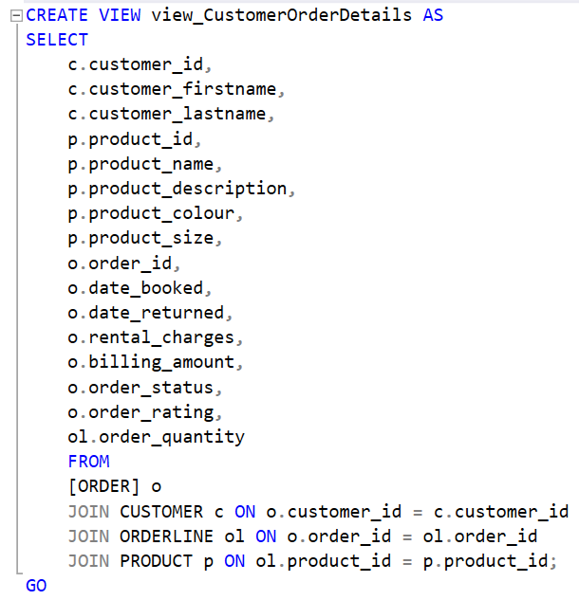
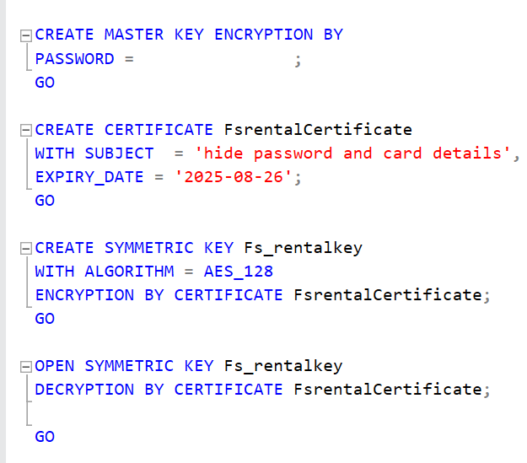

View & Encryption
View of Customer purchase details
Encryption for password and card-details

Slide 7
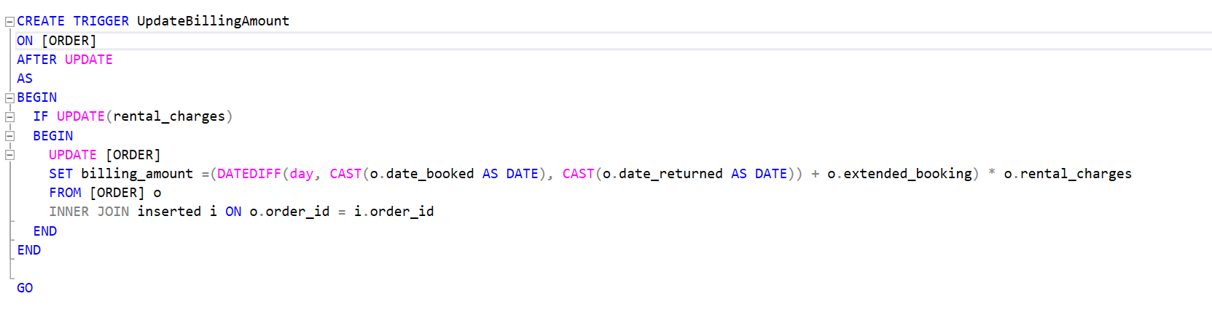
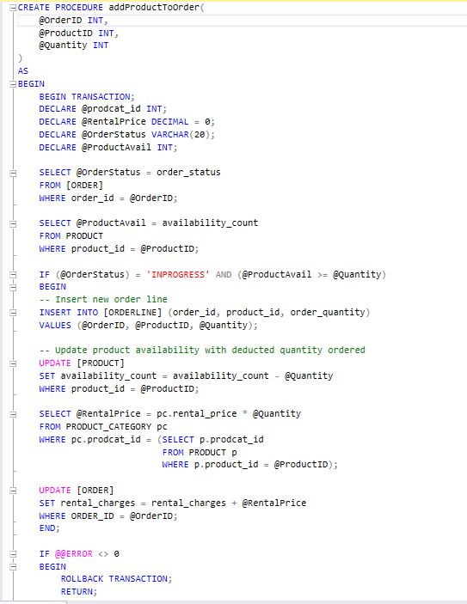
Stored Procedure & Trigger
Stored Procedure
Trigger

Slide 8
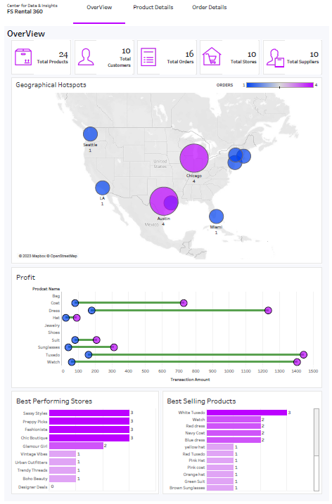
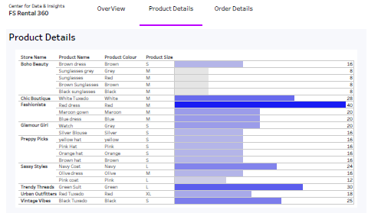
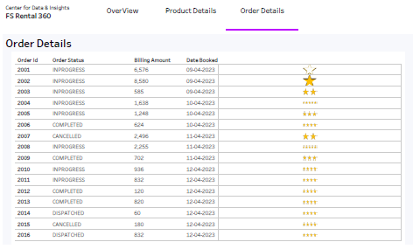
DATA VISUALIZATION USING TABLEAU

